Slide 1
Spring DATA JPA

Slide 2
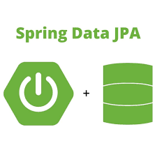
Introduction
Architecture
Table Mapping
Association Mapping
Query
Persistence Context And Entity Life Cycle
Fetching Mode
Transaction

Slide 3
Spring Data
Introduction
The Spring Framework consists of a collection of projects, and one of these projects is Spring Data.
The DAO layer usually consists of a lot of boilerplate code that can and should be simplified. This simplification help:
Reduce of artifacts that need to be defined and maintained
Consistency of data access patterns and consistency of configuration.
Spring Data takes this simplification one step forward and makes it possible to remove the DAO implementations entirely.
To start Spring Data, a DAO interface needs to extend the JPA specific Repository interface. This will enable Spring Data to find this interface and automatically create an implementation for it.

Slide 4
What is Spring Data JPA
Introduction
The Java Persistence API (JPA) is a Java application programming interface specification that describes the management of relational data, reduce the burden of writing codes for relational object management, a programmer follows the ‘JPA Provider’ framework, which allows easy interaction with database instance.
JPA is an open source API, therefore various enterprise vendors such as Oracle, Redhat, Eclipse, etc. provide new products by adding the JPA persistence flavor in them. Some of these products include: Hibernate, Eclipselink, Toplink, Spring Data JPA, etc.
Spring Data JPA, makes it easy to easily implement JPA based repositories. This module deals with enhanced support for JPA based data access layers.

Slide 5
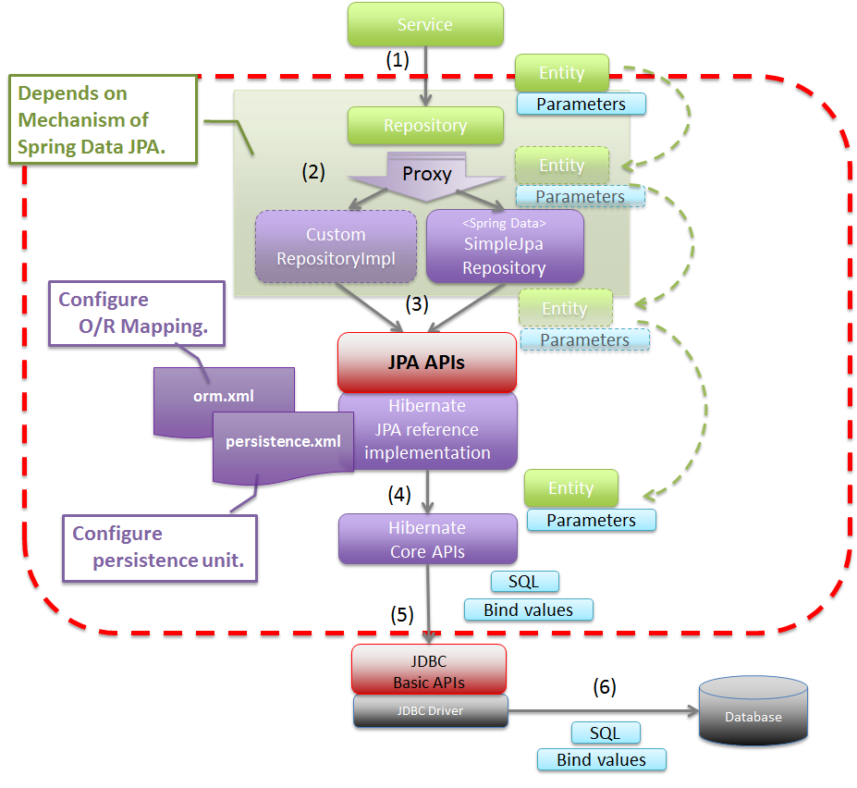
Spring data JPA architecture
Architecture

Slide 6
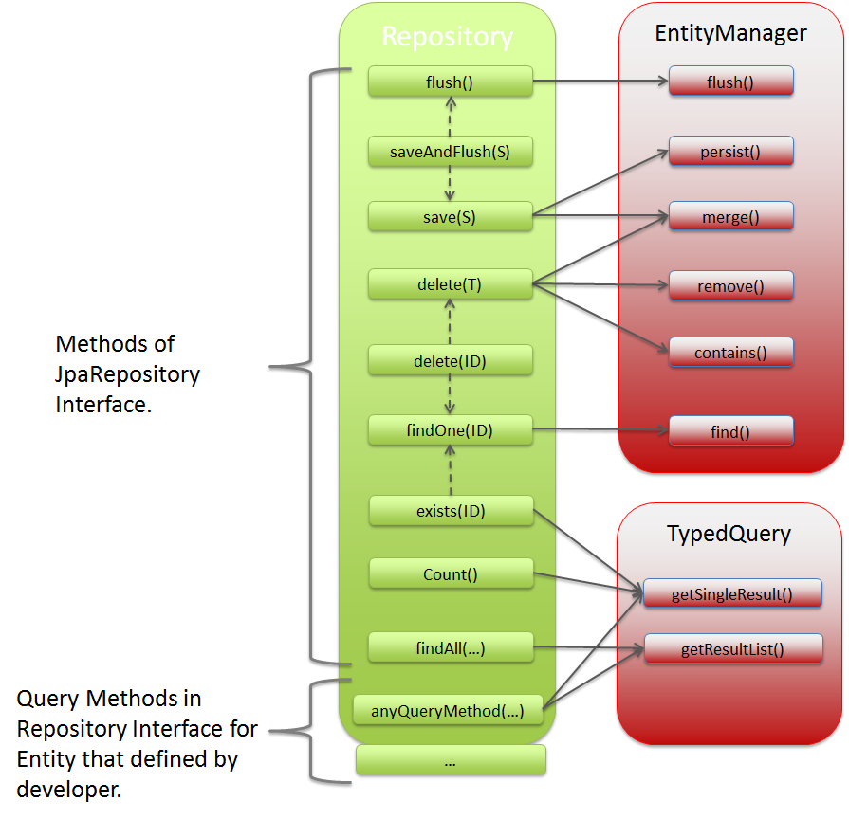
Spring data JPA architecture
Architecture

Slide 7
Entity annotation
Table Mapping
@Entity marks this class as a JPA entity.
@Table annotation just below the @Entity annotation and use its name attribute to specify the table name explicitly
@Column the default column names for entity states
@Id marks a field as a primary key field
@GeneratedValue indicates the value of this field should be generated automatically. Several different value generation strategies can be used
Notes:
Generation strategies
- The Auto Strategy: The same number generator is also used to generate numeric values for primary key fields annotated by @GeneratedValue with the AUTO strategy
- The Identity strategy: also generates an automatic value during commit for every new entity object. The difference is that a separate identity generator is managed per type hierarchy, so generated values are unique only per type hierarchy.
- The Sequence strategy: consists of two parts - defining a named sequence and using the named sequence in one or more fields in one or more classes.
- The Table strategy: the generation table is created by hibernate with name hibernate_sequences and there will be two column sequence_name and sequence_next_hi_value

Slide 8
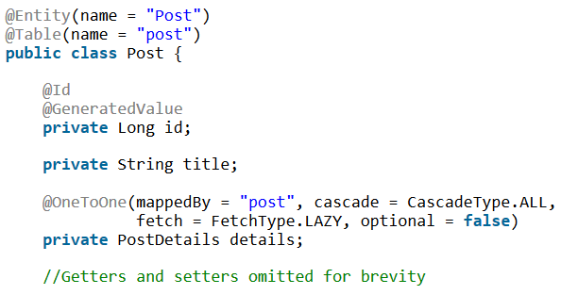
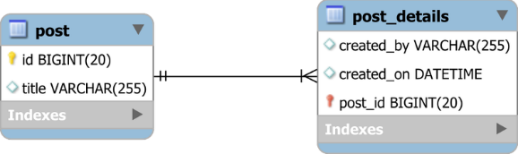
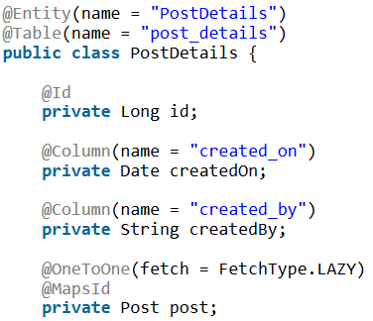
One To One
Association Mapping
@OneToOne relationship is a type of cardinality that refers to the relationship between two entities A and B in which one element of A may only be linked to one element of B, and vice versa.
The best way to map a @OneToOne relationship is to use @MapsId. This way, you don’t even need a bidirectional association since you can always fetch the PostDetails entity by using the Post entity identifier

Slide 9
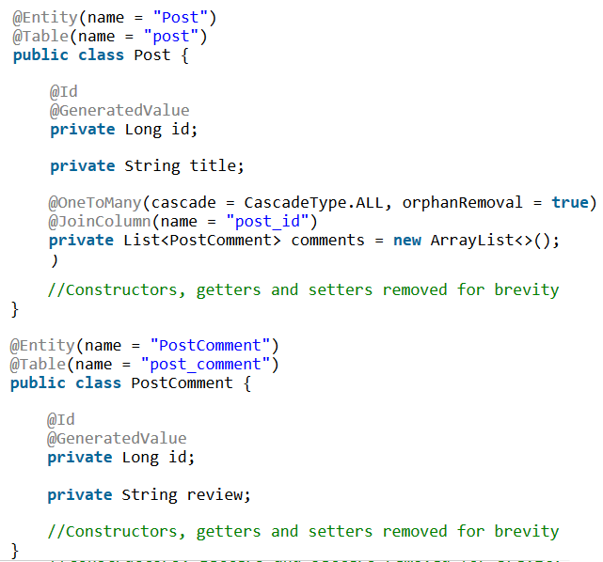
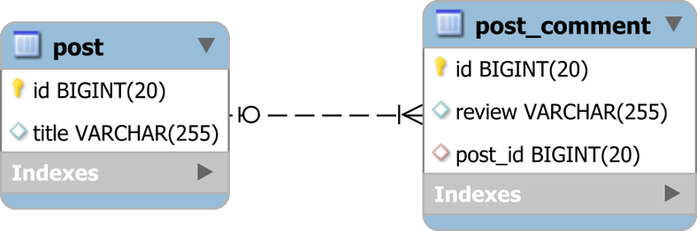
One To Many
Association Mapping
@OneToMany Links two tables based on a Foreign Key column so that the child table record references the Primary Key of the parent table row. As straightforward as it might be in a RDBMS, when it comes to JPA, the one-to-many database association can be represented either through a @ManyToOne or a @OneToMany association since the OOP association can be either unidirectional or bidirectional.
@OneToMany annotation allows you to map the Foreign Key column in the child entity mapping so that the child has an entity object reference to its parent entity.
The @JoinColumn annotation helps Hibernate to figure out that there is a post_id Foreign Key column in the post_comment table that defines this association

Slide 10
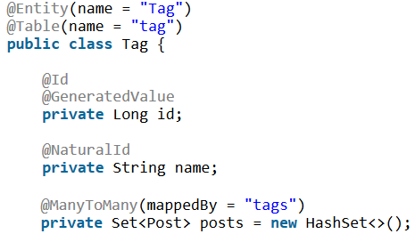
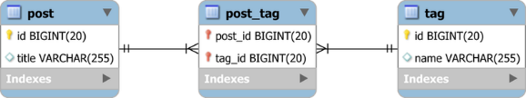
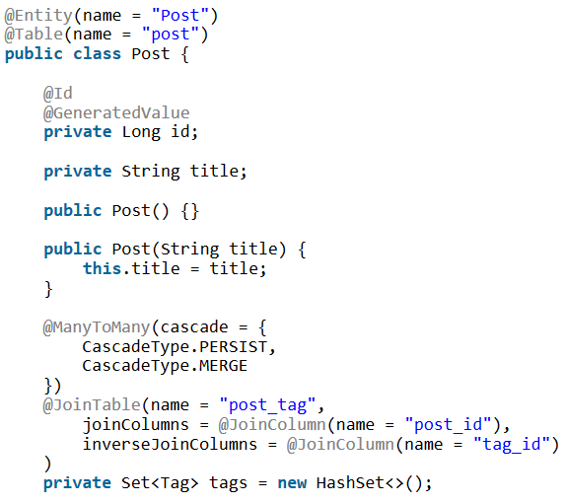
Many To Many
Association Mapping
A typical many-to-many database association includes two parent tables which are linked through a third one containing two Foreign Keys referencing the parent tables.
@joinColumns attribute is responsible for the columns mapping of the owning side. The name attribute contains the column name of the intermediary table. @inverseJoinColumns attribute is responsible for the columns mapping of the inverse side

Slide 11
Spring Data repository
Query
Spring Data already provided 3 interfaces as interface. Each of these defines its own functionality
CrudRepository provides CRUD functions
PagingAndSortingRepository provides CRUD functions
JpaRepository provides JPA related methods such as flushing the persistence context and delete records in a batch

Slide 12
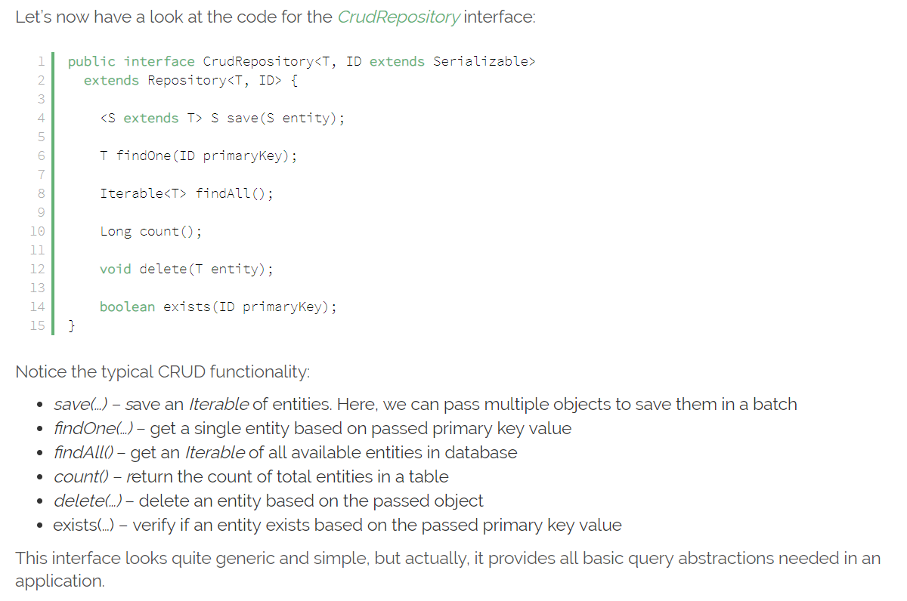
CrudRepository
Query

Slide 13
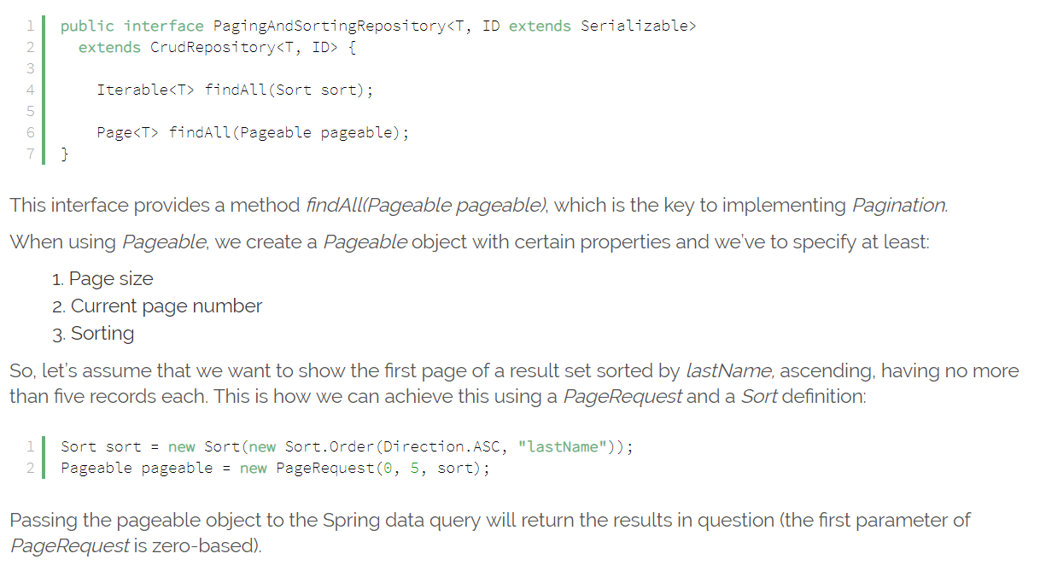
PagingAndSortingRepository
Query

Slide 14
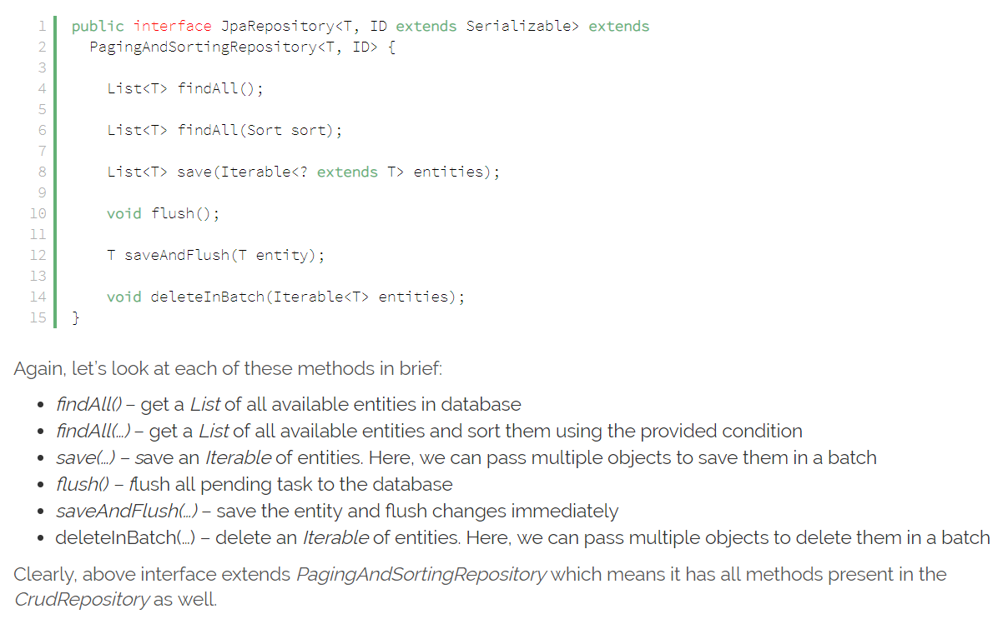
JpaRepository
Query

Slide 15
Query Categories
Query
Creating Database Queries From Method Names
public List<Todo> findByTitleOrDescription(String title, String description);
Creating Database Queries With the @Query Annotation
@Query("SELECT t FROM Todo t WHERE t.title = 'title'")
public List<Todo> findById();
Creating Database Queries With Named Queries
@NamedNativeQuery(name = "Todo.findByTitleIs”,
query="SELECT * FROM todos t WHERE t.title = 'title'",
resultClass = Todo.class
)
Creating Database Queries With the JPA Criteria API

Slide 16
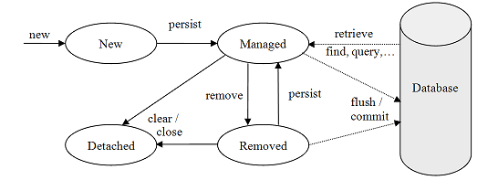
Persistence Context And Entity Life Cycle
The Persistence Context
The persistence context is the collection of all the managed objects of an EntityManager.
The persistence context sits between client code and data store.
It's a staging area where persistent data is converted to entities, ready to be read and altered by client code.
Entity Object Life Cycle
Notes:
When an entity object is initially created its state is New. In this state the object is not yet associated with an EntityManager and has no representation in the database.
An entity object becomes Managed when it is persisted to the database via an EntityManager’s persist method, which must be invoked within an active transaction. On transaction commit, the owning EntityManager stores the new entity object to the database. More details on storing objects are provided in the Storing Entities section.
Entity objects retrieved from the database by an EntityManager are also in the Managed state. Object retrieval is discussed in more detail in the Retrieving Entities section.
If a managed entity object is modified within an active transaction the change is detected by the owning EntityManager and the update is propagated to the database on transaction commit. See the Updating Entities section for more information about making changes to entities.
A managed entity object can also be retrieved from the database and marked for deletion, using the EntityManager’s remove method within an active transaction. The entity object changes its state from Managed to Removed, and is physically deleted from the database during commit. More details on object deletion are provided in the Deleting Entities section.
The last state, Detached, represents entity objects that have been disconnected from the EntityManager. For instance, all the managed objects of an EntityManager become detached when the EntityManager is closed. Working with detached objects, including merging them back to an EntityManager, is discussed in the Detached Entities section.

Slide 17
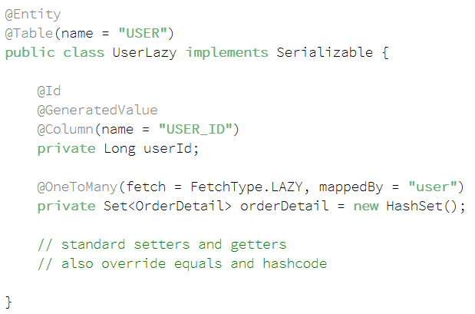
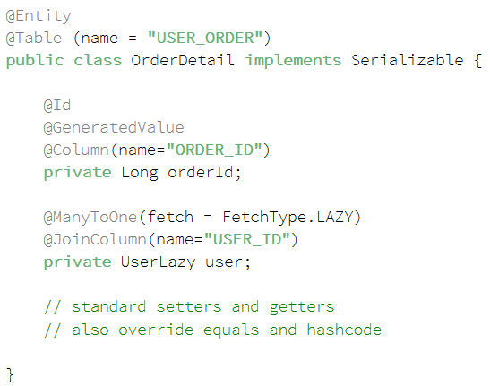
Data fetching/loading mode
Fetching Mode
When working with an ORM, data fetching/loading can be classified into two types: eager and lazy.
Eager Loading is a design pattern in which data initialization occurs on the spot
Lazy Loading is a design pattern which is used to defer initialization of an object as long as it’s possible

Slide 18
Data fetching/loading mode
Fetching Mode
In eager loading strategy, if we load the User data, it will also load up all orders associated with it and will store it in a memory.
lazy loading is enabled, if we pull up a UserLazy, OrderDetail data won’t be initialized and loaded into a memory until an explicit call is made to it.
spring.jpa.show-sql=true
spring.jpa.properties.hibernate.format_sql=true
If you look at a console output then you will be able to see generated queries
For Lazy Loading: select user0_.USER_ID as USER_ID1_0_, ... from USER user0_
For Eager Loading:
select orderdetai0_.USER_ID as USER_ID4_0_0_, orderdetai0_.ORDER_ID as ORDER_ID1_1_0_, orderdetai0_ ...
from USER_ORDER orderdetai0_ where orderdetai0_.USER_ID=?

Slide 19
Data fetching/loading mode
Fetching Mode
Lazy Loading
Advantages:
Initial load time much smaller than in the other approach
Less memory consumption than in the other approach
Disadvantages:
Delayed initialization might impact performance during unwanted moments
In some cases you need to handle lazily-initialized objects with a special care or you might end up with an exception
Eager Loading
Advantages:
No delayed initialization related performance impacts
Disadvantages:
Long initial loading time
Loading too much unnecessary data might impact performance

Slide 20
Data fetching/loading mode
Fetching Mode
What if I need association data when using lazy mode ?
5 ways to initialize lazy associations and when to use them - Thorben Janssen

Slide 21
@Transactional
Transaction
UserTransaction utx = entityManager.getTransaction();
try {
utx.begin();
businessLogic();
utx.commit();
} catch(Exception ex) {
utx.rollback();
throw ex;
}
It's repetitive and error prone
Errors are hard to debug and reproduce
Decreases readability of the code base
What if this method calls another transactional method?
Much more convenient and readable
Transaction propagation are handled automatically
Method will have the option of joining the ongoing transaction
Powerful mechanism hides what is going on under the hood
@Transactional
public void businessLogic() {
... use entity manager inside a transaction ...
}

Slide 22

Q&A

Slide 23
References
https://www.tutorialspoint.com/jpa/index.htm
https://www.petrikainulainen.net/spring-data-jpa-tutorial/
https://www.baeldung.com/the-persistence-layer-with-spring-data-jpa
https://dzone.com/articles/how-does-spring-transactional
https://www.baeldung.com/transaction-configuration-with-jpa-and-spring

